Slide 1



Strategically Planning for Evaluation: Implementation and Utilization Benefits
By: Lori Sugiyama, MPH

Slide 2
Presentation Outline
Evaluation Ideologies used
Basic elements of a strategic evaluation plan
Why this process is beneficial

Slide 3
Ideologies Utilized
Utilization focused evaluation (David Fetterman)
Centers for Disease Control and Prevention Model for Evaluation
Mueller’s findings suggest:
  “ there is a simple dose-response relationship between exposure and utility of evaluation results-the more times a person sees the results, the greater the utility of results.”

Slide 4
The steps…
Establish an Evaluation Team
Develop a description of the program
Prioritize program activities for evaluation
Develop a communication plan
Evaluation design and elements

Slide 5

Establishing an Evaluation Team
The team should be composed of 5-10 individuals:
  Those that know a history of the program
  An Epidemiologist
  Program Manager
  Key opinion leaders

Slide 6
The steps…
Establish an Evaluation Team
Develop a description of the program
Prioritize program activities for evaluation
Develop a communication plan
Evaluation design and elements

Slide 7
Describing the Program
Program Logic model
  Resources, Activities, Outputs, Short-term Outcomes, Intermediate Outcomes and Long-term Outcomes.
General description of all program interventions

Slide 8
The steps…
Establish an Evaluation Team
Develop a description of the program
Prioritize program activities for evaluation
Develop a communication plan
Evaluation design and elements

Slide 9
Capacity Building
At each meeting, I taught a new evaluation concept.
First, prioritization techniques
Second, evaluation designs and methods
Third, process vs. outcome
Giving information on evaluation empowered each member to engage and improved overall understanding.

Slide 10
Prioritize Program Activities
Nominal Group Planning Method
Simplex Method
“Quick and Colorful/Dot Method”
Criteria Weighing Method
  Develop prioritization criteria
  Apply the criteria to the activities
  Give a numerical value for criteria selected

Slide 11
Prioritize Program Activities
Interest | Programs of current/highest interest to stakeholders and program staff
Disparities | Those programs reaching disparate populations
Visibility | Programs most visible in the community and to stakeholders
Activity | Criteria
 | Interest | Disparities | Visibility | total
Recess Guidance (L)
Miners packet (M)
Telehealth 1 (S)
Advocates (M)
Public awareness campaigns (S)
Telehealth 2 (L)
Social Media (L)
Asthma action plans (M)
Childcare trainer prog. (L)

Slide 12
The steps…
Establish an Evaluation Team
Develop a description of the program
Prioritize program activities for evaluation
Develop a communication plan
Evaluation design and elements

Slide 13
Evaluation Design and Elements
Content area | 2010-2011 | 2011-2012 | 2012-2013 | 2013-2014
Surveillance | Data Dissemination | Burden Report | Work-related Asthma
Partnerships | Asthma Action Groups | Listserv |  | Local Health District Grants
Interventions | Telehealth 1 | Recess Guidance | Advocates | Telehealth 2
 |  |  | Social Media

Slide 14

Evaluation Design and Elements
Designs
  Experimental
  Quasi-experimental
  Non-experimental
2. Data Collection Methods
  Qualitative vs. Quantitative
  Mixed Method
3. Type of Evaluation
4. Evaluation Questions

Slide 15
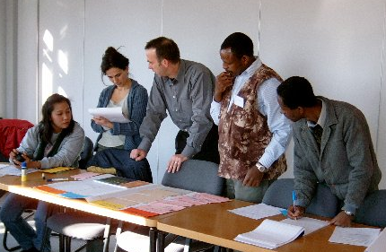
Evaluation Design and Elements
4. Evaluation Models
  Responsive Evaluation
  Goal-free Evaluation
  Utilization-focused Evaluation
  Participatory Evaluation
Notes:
Use of other models by people in the group?

Slide 16
Evaluation Design and Elements
Title of Evaluation | A process evaluation of the Asthma Telehealth Program
Program Component | Interventions
Evaluation Questions | Is the telehealth series reaching the intended audience of health professionals? How is the objective of educating health professionals on the diagnosis and management of asthma being met? In what ways are the message relevant and at the appropriate educational level for the intended audience? What barriers or external factors currently exist? What is the appropriate number of sessions each year?
Evaluation Design/Methods | Non-experimental: Mixed methods
Data Sources | Pre/post tests, evaluation reports, registration information
Data Collection Methods | Document Review, Key Informant Interviews
Data needs | Participant Information for follow-up
Cost of Evaluation | Evaluator and Heath Educator hours

Slide 17
Evaluation Design and Elements
Figure 2: Evaluation Timeline: Years 2-3
Evaluation Activity | 2011 2012
 | Sept | Oct | Nov | Dec | Jan | Feb | Mar | Apr | May | June | July | Aug | Sept | Oct | Nov | Dec
Surveillance: Data Dissemination
Partnerships: Asthma Action Groups
Interventions: Asthma Action Plans
Interventions: Telehealth 1
Surveillance: Burden Report
Partnerships: Listserv
Interventions: Recess Guidance
Interventions: Public Awareness Campaign

Slide 18
The steps…
Establish an Evaluation Team
Develop a description of the program
Prioritize program activities for evaluation
Develop a communication plan
Evaluation design and elements

Slide 19

Develop a Communication Plan
Identify key messages
Choose dissemination methods
Identify who is responsible for the communication

Slide 20
Communicating Results
Supply specific action-oriented recommendations
Use graphics to communicate results
Use a wide range of reporting mechanisms
Develop simple, usable, and visual summary reports

Slide 21
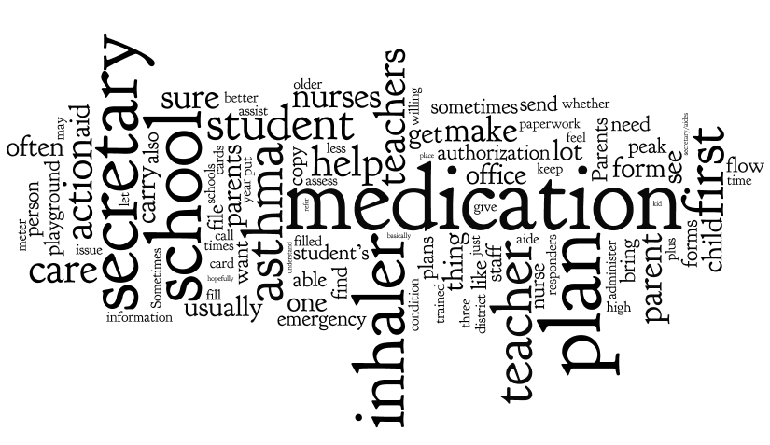
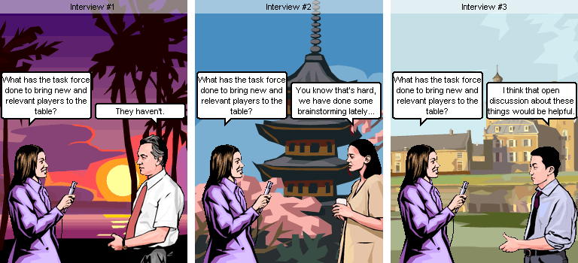

Communicating Results
Cartoons/comics
word clouds

Slide 22
Builds a “Culture” of Evaluation
Leadership support
Capacity building:
“Now before I start a program, I think, how will we evaluate this…what data needs to be collected.”
Understanding the methodology increases validity and use

Slide 23
Benefits continued
Better capacity to collect data for more comprehensive evaluations
Studies suggest that timing is a critical component in evaluation use, this improves the timing of evaluations
“You know that the evaluation is coming and so you work harder because you know you will be held accountable for the results”

Slide 24
Sources
Centers for Disease Control and Prevention. (2010). Learning and growing through evaluation: state asthma program evaluation guide. Atlanta, GA.
Grasso, P. (2003). What makes an evaluation Useful? Reflections from experience in large organizations. Amer Journal of Evaluation, 24(4), 507-513.
Johnson, K., Greenseid, L., Toal, S., King, J., Lawrenz, F., & Volkov, B. (2009). Research on evaluation use: a review of the empirical literature from 1986-2005. American Journal of Evaluation, 30, 377.
Mueller, N., Burke, R., Luke, D., & Harris, J. (2008). Getting the word out: multiple methods for disseminating evaluation findings. J Public Health Mgt Prac, 14(2). 170-176.
Patton, M. (2003). Qualitative Evaluation Checklist. Evaluation Checklist Project: Western Michigan University. www. Wmich.edu/evalctr/checklists

